Slide 1
Machine Learning Project II Report

Slide 2


Team Members:
M
Mostafa Mahmoud Salah
Mohamed Ahmed Ramadan

Slide 4

2) Read the data (regression_data.csv)
1)Store path of the data file into (PATH) var
2)Load data into (DATA) var using Pandas func. (read_csv) and it needs three arguments:
•first: the path of file
•second: header is the first row of the file, sometimes first row has the names of Columns, but in our case we don’t have it so, header → null
• three: names of columns column ones and column input and output

Slide 5
3) Plot the Data

Slide 6
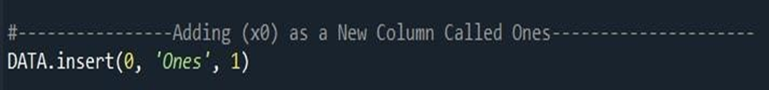

4) Make new column for x0 and its values=1 and insert it in our data
5) Separation data into X (Training Data) & Y (Target Outputs)
The shape of data is the data dimensions ➔ 97x3
iloc func. used to split the data:
X= [All Rows: col_0, col_1] ➔ 97x2 (X0, X1)
Y= [All Rows: col_2] ➔ 97x1 (Y)

Slide 7
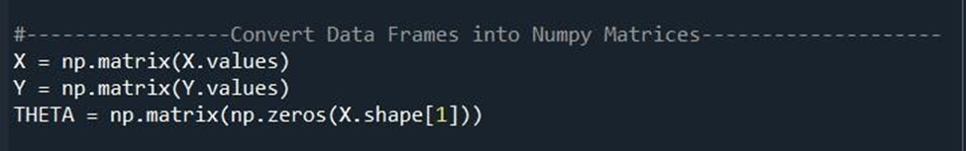
6) Convert pandas data frames into numpy matrices and make theta matrix
converting using numpy func. (np.matrix)
make theta dimensions based on the number of features of input data, and make theta(s) values → 0 as initial value
we multiply 2 in len(X) = 97, because this equation for single data point

Slide 8
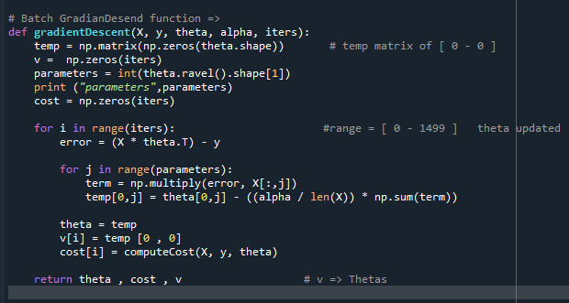
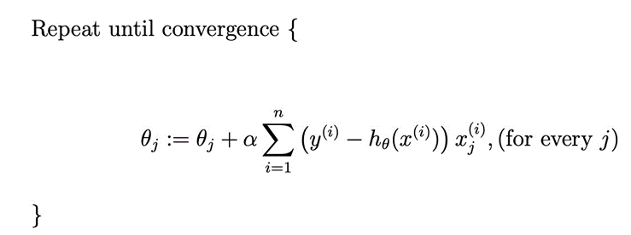
9) Batch Gradient Descent:
The Source Equation:

Slide 9

➢We will create matrix 1*2 for matrix and its values = Zero → temp ➢ Put in PARAMETERs var num. of col. of theta matrix.
➢COST var = matrix with 1500 zero to store cost_value_history.
➢First Loop will loop from 0 to 1499 for every iteration we compute (h(x) - y).
➢Second loop will loop for two times j = 0,1 and multiply every (h(x) – y) in X0 values and (h(x) – y) in X1 into → term,
➢then compute both of new theta values, in first loop after inner loop we update theta(s) and store cost value for these theta(s),
➢Finally we return the Final Theta(s) and cost_value_history
10) Initialize Learning Rate and number of Epochs
11) Run the Batch Gradient Descent :

Slide 10
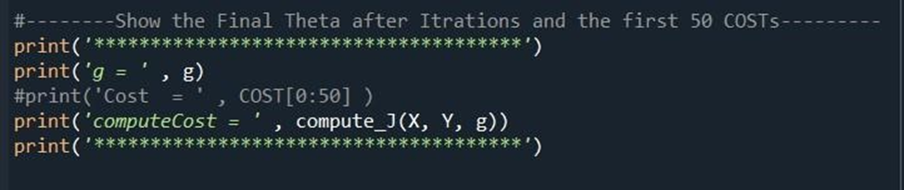
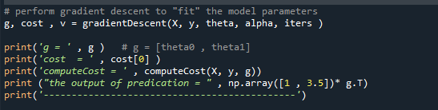

12) Print Final theta and Final Cost
g = [[-3.63029144, 1.16636235]] computeCost = 4.483388256587726
Given input = [1, 3.5], what is the predicted output from your model?

Slide 11
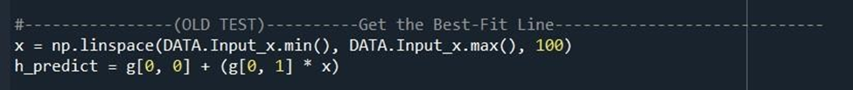
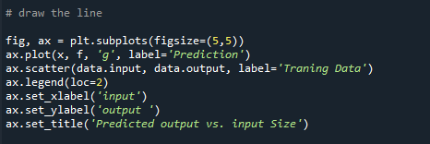
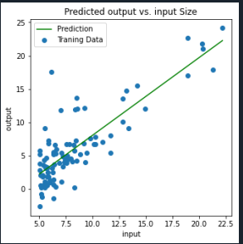
13) Generate Test data from Training data using linspace and predict outputs
- numpy.linspace is split any two numbers into multiple numbers between these two numbers. - apply 𝜃₀ + (𝜃₁* 𝑥) for all data points 14) Plot data with the best-fit line

Slide 12
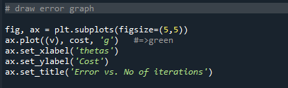
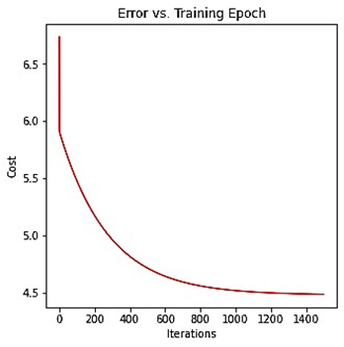
15) Plot Error Graph : {cost with Epochs}

Slide 13
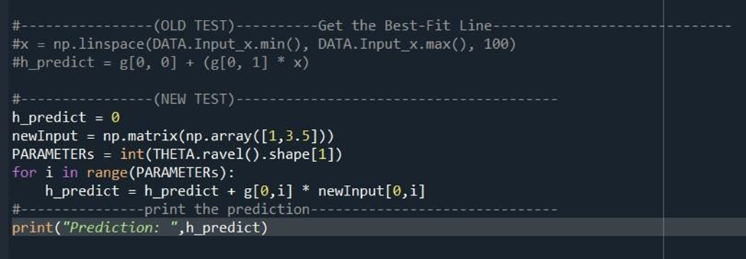
17) Test New Input [1,3.5] and Print the prediction
Prediction = 0.45197678677017716

Slide 14
Thank you
Mostafa Mahmoud salah
Mohammed Ahmed Ramadan
mm4581@fayoum.edu.eg
Ma4539@fayoum.edu.eg

